Slide 1







2019 Stack Overflow Developer Survey Results
Norapat Kittivises
23/11/2024

Slide 2



OUTLINE
Executive Summary
Introduction
Methodology
Results
Visualization – Charts
Dashboard
Discussion
Findings & Implications
Conclusion
Appendix

Slide 3

EXECUTIVE SUMMARY
Data contextualization and analysis goal
Methodology description
Date gathering
Data analysis
Data visualization
Results of findings supposed by visual graphs and trends
Discussion of overall findings & implications

Slide 4

INTRODUCTION
Stack Overflow’s annual Developer is one of the largest developer survey in the world with nearly 90,000 respondents.
Results does not represent all developer within the community.
Trends to predict the shift in technologies tools.

Slide 5

METHODOLOGY
Data Collection
Web Scraping
APIs
Request Library
Data Wrangling
Exploratory Data Analysis
Analyzing data distributions
Handing outliers
Finding Correlations
Data Visualization
Dashboards

Slide 6
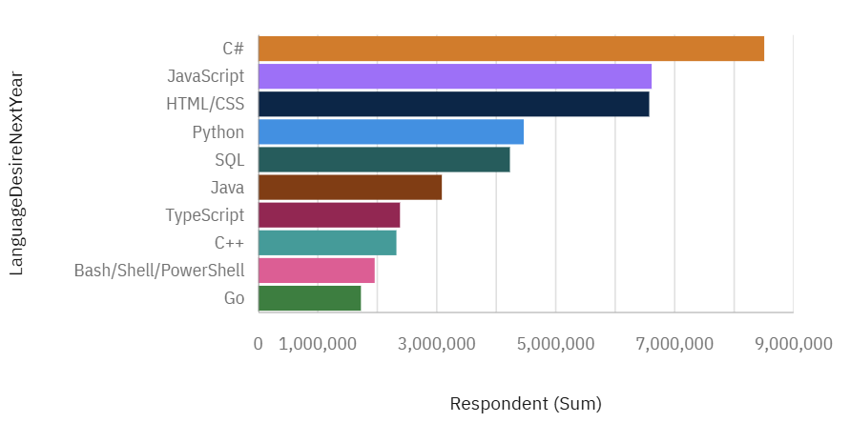
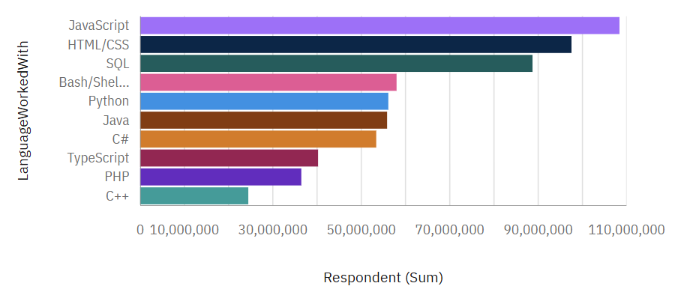
PROGRAMMING LANGUAGE TRENDS
Current Year
Next Year

Slide 7
PROGRAMMING LANGUAGE TRENDS - FINDINGS & IMPLICATIONS
Findings
C# will overtake JavaScript as a leading language
Usage of JavaScript, HTML&CSS drops
Implications
Usage of SQL decreases

Slide 8
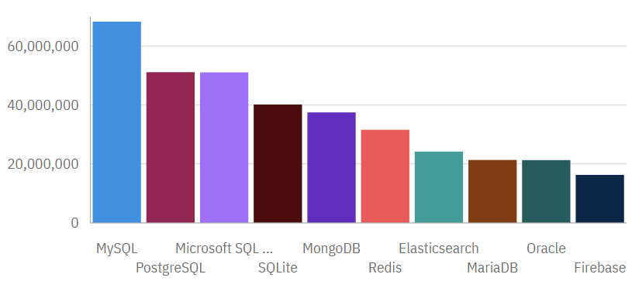
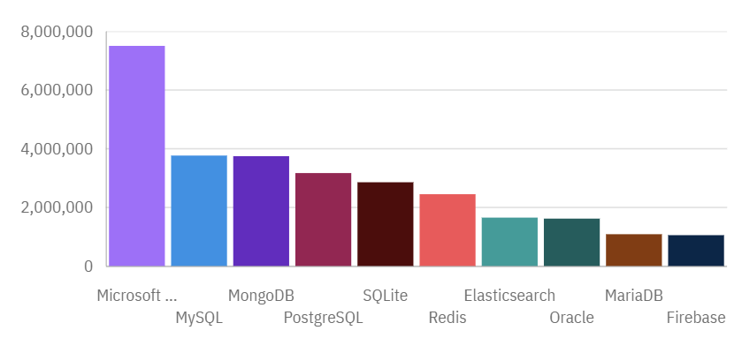
DATABASE TRENDS
Current Year
Next Year

Slide 9
DATABASE TRENDS - FINDINGS & IMPLICATIONS
Findings
MySQL usage will decreases
Monga usage will increases
Implications
Developer seems to be migrating to Microsoft SQL

Slide 10

DASHBOARD
https://github.com/DebuggingMyLife/IBM-Data-Analyst-Capstone-Project/blob/main/Peer-Graded%20Assignment_%20Part%20A%20-%20Building%20a%20dashboard%20with%20IBM%20Cognos%20Analytics.pdf

Slide 11
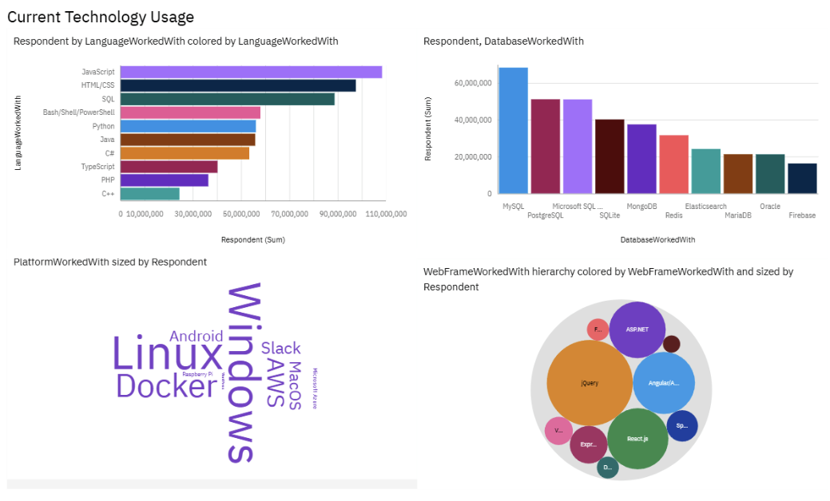
CURRENT TECHNOLOGY USAGE

Slide 12
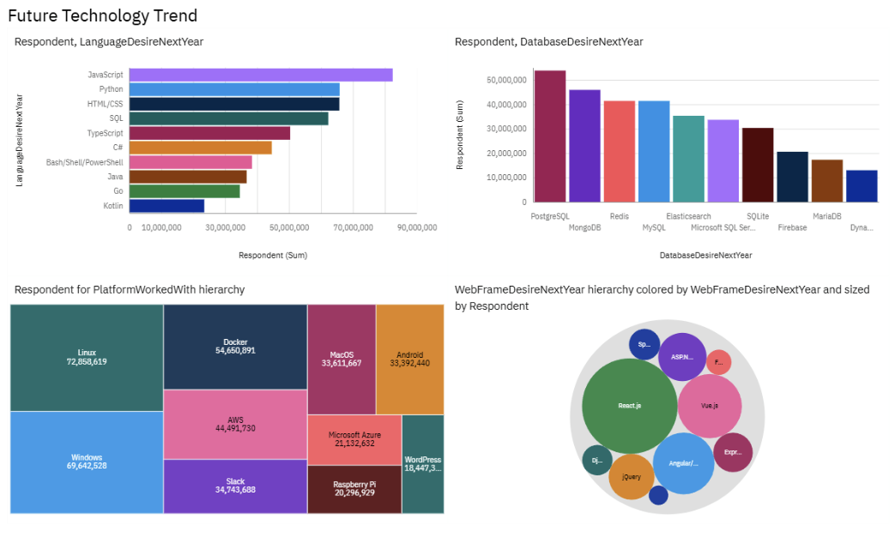
FUTURE TECHNOLOGY TREND

Slide 13
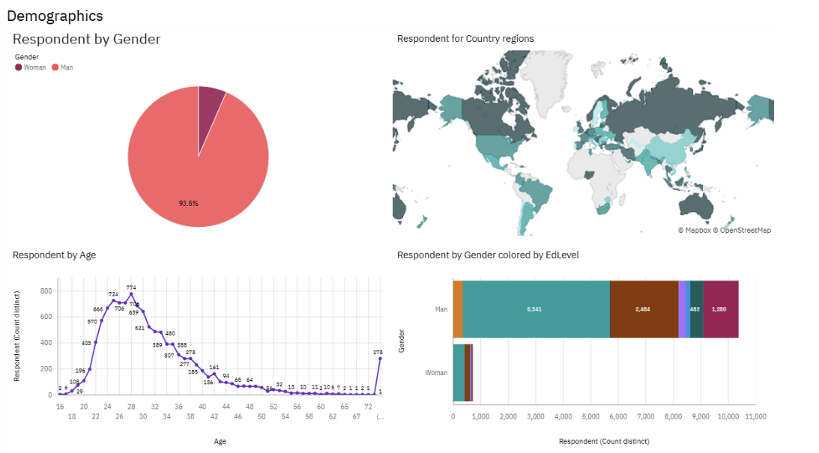
GLOBAL DEMOGRAPHICS

Slide 14
DISCUSSION
https://ap1.ca.analytics.ibm.com/bi/?perspective=dashboard&pathRef=.my_folders%2FPeer-Graded%2BAssignment%253A%2BPart%2BA%2B-%2BBuilding%2Ba%2Bdashboard%2Bwith%2BIBM%2BCognos%2BAnalytics&action=view&mode=dashboard&subView=model00000193547cee82_00000000

Slide 15
OVERALL FINDINGS & IMPLICATIONS
Findings
JavaScript are widely used and C# is getting popular
Over 93% are male developer in their 20s
Developer are mostly located in developer countries (USA, Canada, Australia, etc.)
Implications
C# becoming increasingly popular.
The gender demographic of developers
The geographic distribution of developers

Slide 16

CONCLUSION
Developers tends to be young male from a developed countries
The popularity trends of different technology tools can be obtained
There need to be a shift in the demographic and geographical trends of developers, expanding the labor market into more countries.

Slide 17
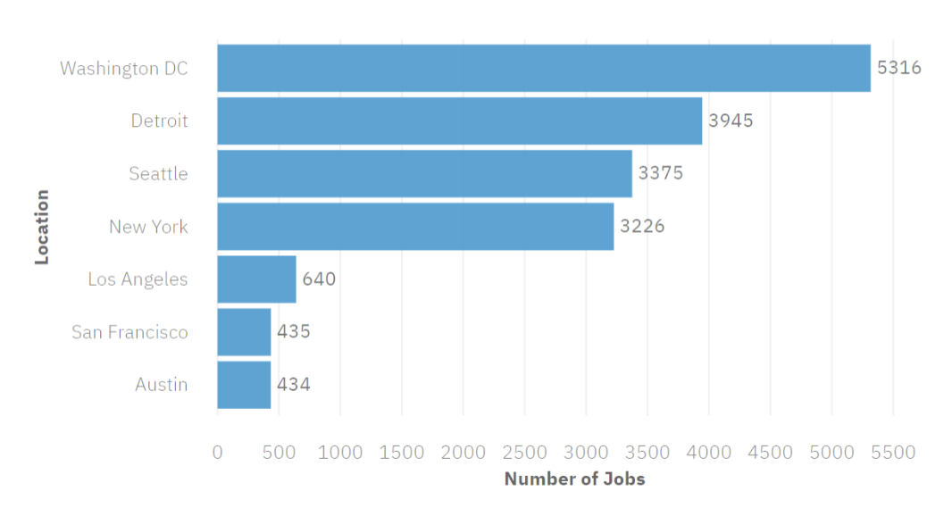
JOB POSTINGS

Slide 18
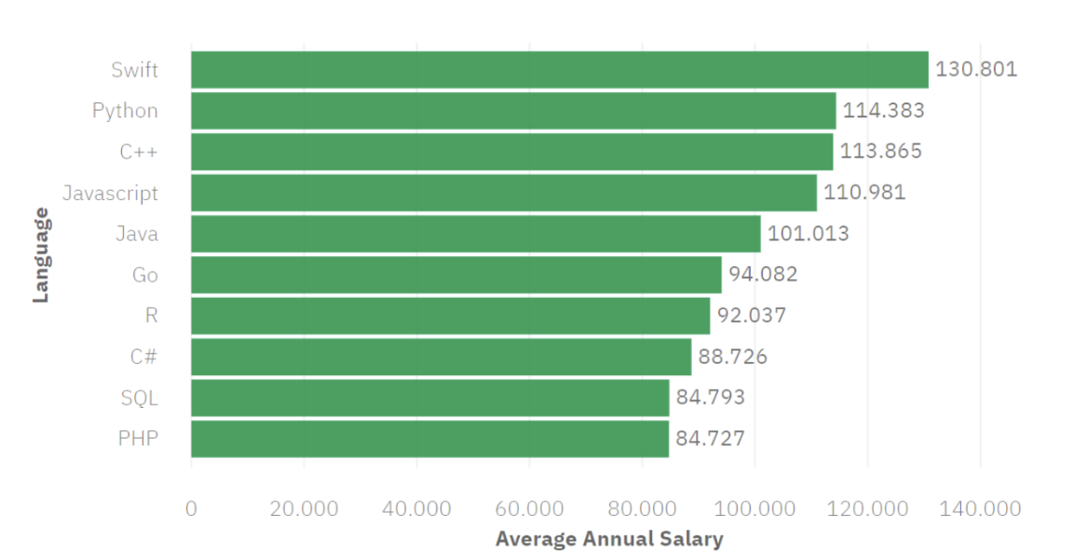
POPULAR LANGUAGES

